Slide 1
RoBoat
Autonomous Submersible Data Collection System
Max Brodheim
Will Elliman
Hayes Torrence
James Monaco
Hobart and William Smith Colleges
Hackathon 2019

Slide 2
Research Process
1
2
3
4
Identify a Problem
Collect Data
Analyze Data
Develop a Solution
Find an issue that needs a solution. In our case, Water Pollution
Collect quantitative information about the environment
Determine what your data says about the problem
Begin to formulate a plan from the collected data
Notes:
Water Pollution is a huge problem that no one person in this room is equipped to tackle. However, every group in this room has come up with great ideas for solutions to some specific problems. Data Collection is absolutely essential to any and all potential solutions, be information about particulates, dissolved pollutants, or anything else. By providing the research and entrepreneurial community access to accurate data, we can apply our skillset to the overall problem.

Slide 3
Research Process
1
2
3
4
Identify a Problem
Collect Data
Analyze Data
Develop a Solution
Find an issue that needs a solution. In our case, Water Pollution
Collect quantitative information about the environment
Determine what your data says about the problem
Begin to formulate a plan from the collected data
Notes:
Water Pollution is a huge problem that no one person in this room is equipped to tackle. However, every group in this room has come up with great ideas for solutions to some specific problems. Data Collection is absolutely essential to any and all potential solutions, be information about particulates, dissolved pollutants, or anything else. By providing the research and entrepreneurial community access to accurate data, we can apply our skillset to the overall problem.

Slide 4
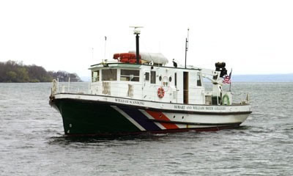
Data Collection in Three Dimensions
Surface Sampling
Uses research vessels
Limited by human abilities and depth

Slide 5
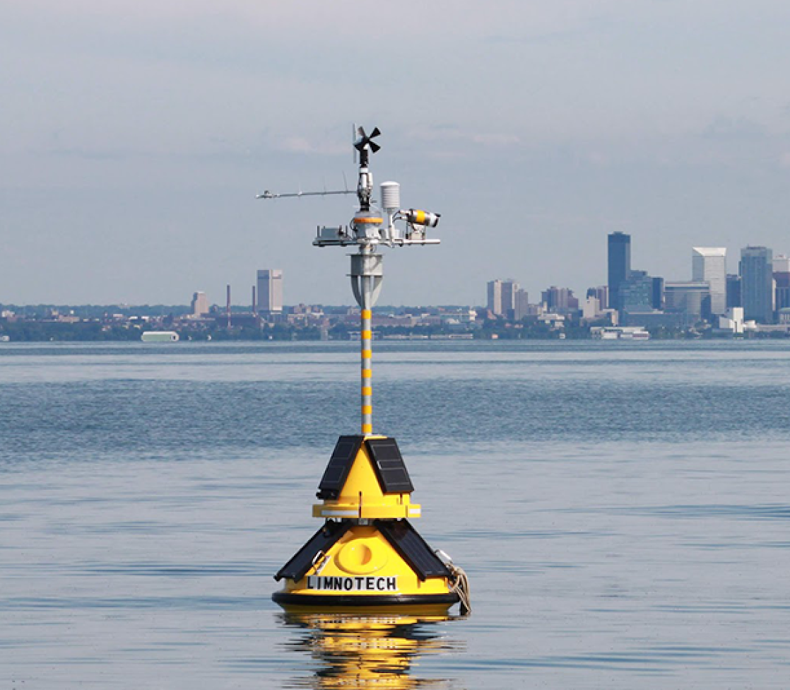
Data Collection in Three Dimensions
Surface Sampling
Uses research vessels
Limited by human abilities and depth
Buoys
Can only sample one vertical column
Requires humans to move them

Slide 6
RoBoat
Autonomous Piloting
Programmable Data Collection at Depths up to 40m
RoBoat to RoBoat Communication
Live Data Feeds
Network Obstacle Avoidance
GPS Tracking

Slide 7
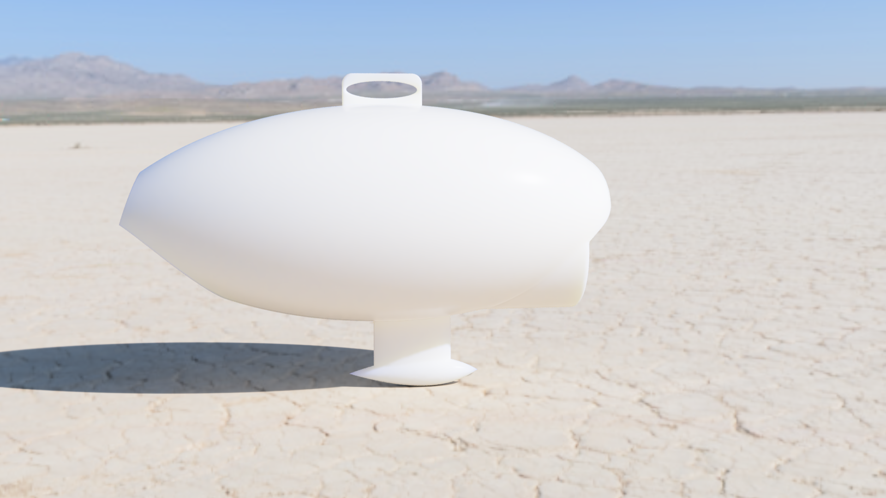
RoBoat
Sensor Suite:
Dissolved O₂
Salinity
pH
Turbidity (visibility)
Dissolved Nitrates
Depth
Temperature
Current Flow Rate
Sampling Suite:
Microplastics Sampling
Water Sampling
Phosphate
Cyanobacteria
Particulate Pollutants

Slide 8
RoBoat and the Status Quo
Cost
Range
Maintenance
Boats require multiple trained people to operate
Fair Weather and Daylight are needed for humans to be safe
Buoys require Frequent Repositioning
Maintaining research vessels is Expensive
Personnel Costs are always high
Scales Poorly with more Data Collection
Research Vessels can only gather data from one point at a time
Buoys are limited to single locations
Buoy require expensive moorings
Costs of ownership for a research vessel can exceed $100,000 a year
RoBoat requires one upfront investment
Requires one technician to operate many drones
RoBoat networks can cover wider areas
Mesh Network is infinitely expandable
RoBoat uses commercial parts
Modular construction eases repairs

Slide 9
Impact of RoBoat
Data Collection
Researchers and Entrepreneurs
Policy Makers
Practical Solutions
Data-Driven Modeling
Targeted Social Policies
Education and Public Outreach

Slide 10
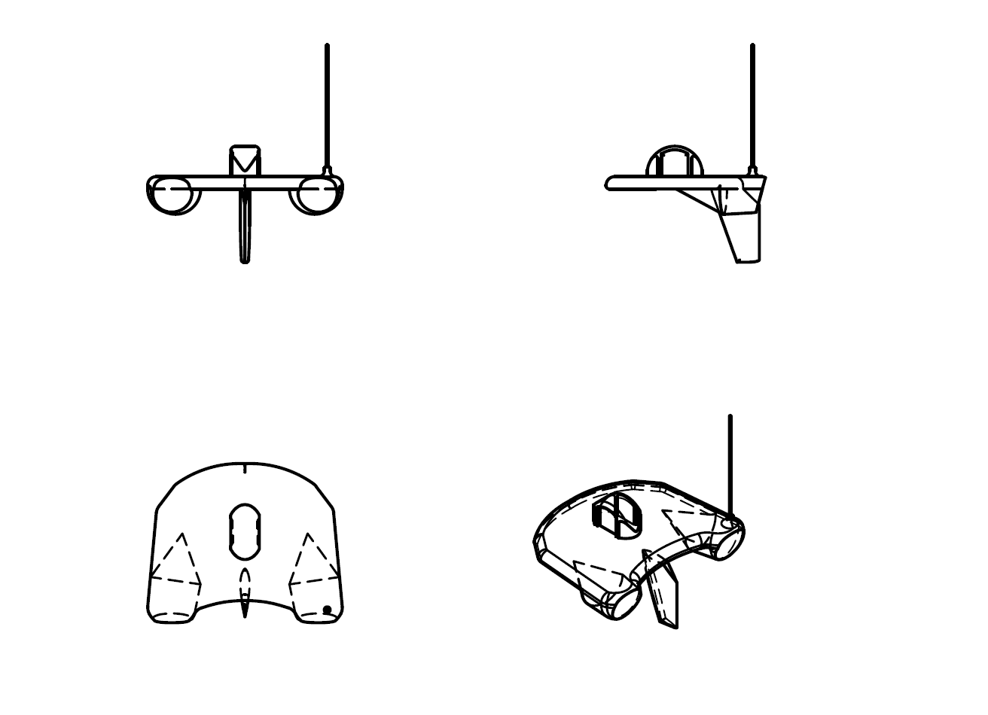
Today
Rapid Prototyping
Problem Analysis
Cost Analysis
Produce Preliminary Design
1-2 Years
Development
Communicate with Researchers
Construct Mechanical Frame
Sensor Integration
2+ Years
Production
Determine Production Location
Source Materials
Streamline Physical Construction
Provide Units to Users
4+ Years
Long Term Support
Source Materials to Ensure long-term repairability
Provide Technical Support to Users

Slide 11
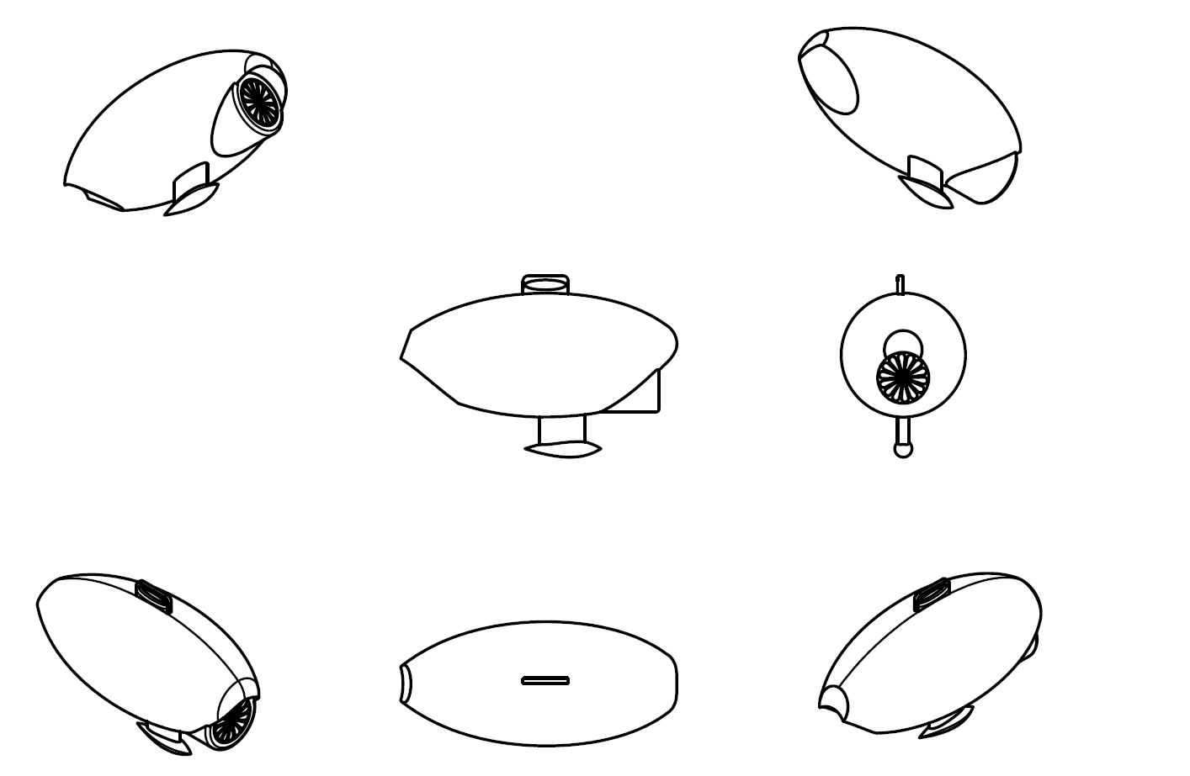
Today
Rapid Prototyping
Problem Analysis
Cost Analysis
Produce Preliminary Design
1-2 Years
Development
Communicate with Researchers
Construct Mechanical Frame
Sensor Integration
2+ Years
Production
Determine Production Location
Source Materials
Streamline Physical Construction
Provide Units to Users
4+ Years
Long Term Support
Source Materials to Ensure long-term repairability
Provide Technical Support to Users

Slide 12
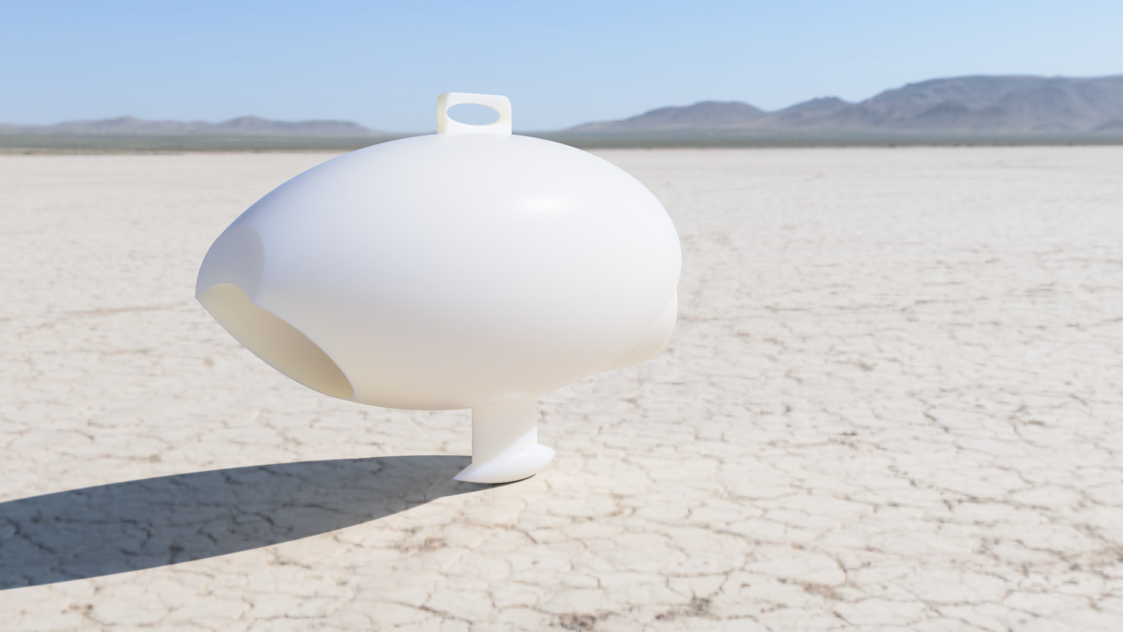
Today
Rapid Prototyping
Problem Analysis
Cost Analysis
Produce Preliminary Design
1-2 Years
Development
Communicate with Researchers
Construct Mechanical Frame
Sensor Integration
2+ Years
Production
Determine Production Location
Source Materials
Streamline Physical Construction
Provide Units to Users
4+ Years
Long Term Support
Source Materials to Ensure long-term repairability
Provide Technical Support to Users

Slide 13
Today
Rapid Prototyping
Problem Analysis
Cost Analysis
Produce Preliminary Design
1-2 Years
Development
Communicate with Researchers
Construct Mechanical Frame
Sensor Integration
2+ Years
Production
Determine Production Location
Source Materials
Streamline Physical Construction
Provide Units to Users
4+ Years
Long Term Support
Source Materials to Ensure long-term repairability
Provide Technical Support to Users

Slide 14
Cost Analysis
Sensor Suite |  | Physical Construction
Dissolved O₂ Probe w/ Temp Hanna Instruments | $190.00 | Injection Molding Construction | $2000.00
Dissolved Nitrate Probe Cole Parmer | $316.80 | Fiberglass Parts | $300
Salinity Sensor Vernier Instruments | $119.00 | Computational Electronics | $40
Depth/Pressure Blue Robotics | $68.00 | Communication Electronics | $40
LIDAR (Range Finding) (x5) Mouser | $49.94 | Hardware: Cabling, Annenta, Lighting | $50
GPS Module SparkFun Electronics | $199.00 | Solar Panels | $300
 |  | Power Systems and Motors | $130
Total: |  |  | $3,851.80

Slide 15
Additional Economic Considerations
Additional Costs:
Prototype Manufacturing Costs - Unknown
RoBoat Employee Salary costs
$55,000 per employee Annually
Office Space Costs (Location Dependent)
Testing, R&D - $5,000 to $10,000 with institutional partnership
Buyers
Research Institutions
Environmental watchdog groups
Governmental research departments

Slide 16
Questions?
Max Brodheim
Will Elliman
Hayes Torrence
James Monaco
RoBoat
Hackathon 2019

Slide 17
Image Sources
Title back background: https://hginthesea.files.wordpress.com/2011/11/img_0291.jpg
Buoy Image: https://www.noaa.gov/stories/smart-buoys-and-noaa-models-are-helping-city-prevent-drinking-water-crisis
William Scandling Research Vessel Image: https://www.hws.edu/fli/sos_scandling.aspx

